Slide 1
Matrix Hierarchies
Building Game Worlds with Transforms
Programming – Maths for Games

Slide 2
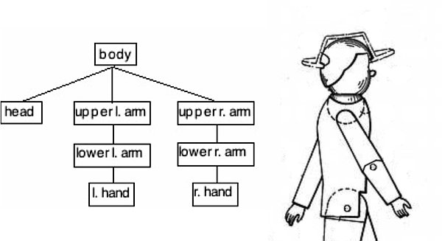
Content
Matrix Concatenation
Scene Hierarchies
Matrix Hierarchies
Scene Objects

Slide 3
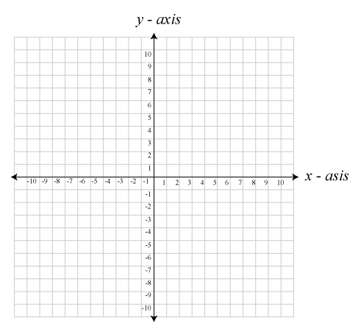



Matrix Concatenation
We’ve seen that multiplying matrices together combines their effects
$$A$$
$$B$$
$$A∙B$$

Slide 4







Matrix Concatenation
If we use a Matrix $M$ to represent a Game Object’s transform in a game world, how would we rotate it $π$ on the spot?
$$R=\left[\begin{matrix}cos(a) & −sin(a) \\ sin(a) & cos(a)\end{matrix}\right]$$
$$M$$
$$M∙R$$
$$M^{′}=M∙R$$

Slide 5


Matrix Concatenation
Now what if we wanted to rotate the Turret separately from the rest of the Tank?
We could give the Turret its own Matrix and apply the same movement to it that we do to the Tank, then apply any additional movement for the Turret
But wait!
Why duplicate the same movements as the Tank then apply a small change, when we can simply store the small change as the Turret’s transform, then simply combine it with the Tank’s transform when drawing!
This is the basis for a Scene Hierarchy, or Scene Graph
$$Parent=TankTransform$$
$$Child=TurrentTransform$$
$$ActualTurretTransform=Parent×Child$$

Slide 6
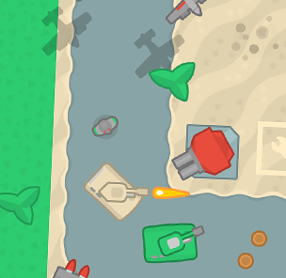
Scene Hierarchies
Scenes in video games and computer graphics are made up of many different objects attached to each other
These connections form a hierarchy
Commonly called a Scene Graph
In a hierarchy, objects may be the Parent of many Child objects, but a Child will only have one Parent
In this example a Tank is a parent to a Turret and a child to the Game World
The object at the top of the hierarchy is called the Root of the scene
Game World
Tower
Tree
Turret
Tank
Tank
Turret
Turret

Slide 7
Scene Hierarchies
Game World
Tower
Tree
In a scene hierarchy, movements applied higher up in the hierarchy also effect all objects below it in the hierarchy
If we move a Parent all Children move with it
Movement applied to a Child will not effect the Parent
It will only effect the Child and any Children the Child has
Turret
Tank
Tank
Tank
Turret
Turret
Turret
Game World
Tower
Tree
Turret
Tank
Tank
Turret
Turret
Turret

Slide 8
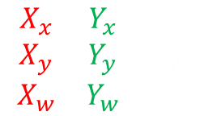
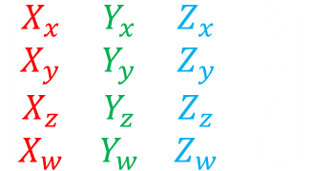
Matrix Hierarchies
We control these movements through the use of Transforms
Every object will typically have a Transform that is relative to its parent
When we use the object for something, like drawing, we usually need to know where it is relative to the game world and not to their parent!
To find where a child object is relative to the game world we simply combine its transform with its parent’s “relative to the world” transform
This may require us to find the parent’s “relative to the world” transform first, and its parent’s, and its parent’s parent, etc
$$\left[\begin{matrix}X_{x} & Y_{x} & T_{x} \\ X_{y} & Y_{y} & T_{y} \\ X_{w} & Y_{w} & T_{w}\end{matrix}\right]$$
$$\left[\begin{matrix}X_{x} & Y_{x} & Z_{x} & T_{x} \\ X_{y} & Y_{y} & Z_{y} & T_{y} \\ X_{z} & Y_{z} & Z_{z} & T_{z} \\ X_{w} & Y_{w} & Z_{w} & T_{w}\end{matrix}\right]$$

Slide 9
Scene Objects
Scene Objects can be implemented in different ways, but they typically…
Have a collection of Child objects
Have some way to access their Parent object
For example, in C++ this may be a pointer
Have a Transform that is relative to their Parent
Usually referred to as their Local Transform
Sometimes store a Transform that is relative to the world
Referred to as the Global or World Transform
class GameObject {
GameObject* m_parent;
std::vector<GameObject*> m_children;
Matrix3 m_localTransform;
Matrix3 m_globalTransform;
};
GameObject* m_sceneRoot = new GameObject();
Here is part of a potential 2-D GameObject class that uses Homogeneous Transforms and implements a Scene Graph

Slide 10
Scene Objects
When moving a Scene Object you would manipulate its Local Transform
We need to ensure that after any changes have been applied to the Local Transform that we then update the Global Transform for the Scene Object and its children
There are many variations on how to implement this…
Some implementations automatically update Global Transforms when the Local is changed
Some implementations keep track of all objects that have changed their Local Transform and tag them as “dirty”
When any other system needs to use a Global Transform it first checks to see if it is “dirty”, and if it is it then updates it and unmarks it as dirty
And other implementations might delay the update of all Global Transforms and do it once per-frame for all scene objects, starting at the scene’s Root and recursing down through the scene
void GameObject::rotate(float angle) {
Matrix3 m = {
cosf(angle), -sinf(angle), 0,
sinf(angle), cosf(angle), 0,
0, 0, 1
};
m_localTransform = m_localTransform * m;
};
An example of manipulating the 2-D Local Transform of the previous class example

Slide 11
Updating Global Transforms
Below is an example method for the previously shown class
The method recursively updates the Global Transform for an object and its children
It combines its parent’s Global with the object’s Local
If there is no parent then the object is relative to the world and so its Local Transform is its Global Transform
void GameObject::updateGlobalTransform() {
if (m_parent != nullptr)
m_globalTransform = m_parent->m_globalTransform * m_localTransform;
else
m_globalTransform = m_localTransform;
for (auto child : m_children)
child->updateGlobalTransform();
};

Slide 12
Summary
Game worlds are made up of game objects attached to other game objects, moving together throughout our 2-D and 3-D spaces
This forms a Scene Graph
Scene Objects can use this hierarchy, combined with transforms local to their parent and global to the game world, to easily maintain these spatial relationships
Using the Local Transform and Global or World Transform

Slide 13
Further Reading
Dunn, F, Parberry, I, 2011, 3D Math Primer For Graphics And Game Development, 2nd Edition, CRC Press
Lengyel, E, 2012, Mathematics for 3D Game Programming and Computer Graphics, 3rd Edition, CENGAGE Learning

